Slide 1
IT257- Design and analysis of algorithms
Mid term evaluation

Slide 2
PROJECT MEMBERS
SALIQ GOWHAR KHAN
BHAVYA
ASHUTOSH KUMAR GUPTA
211AI043
211AI011
211AI008

Slide 3
Optimal path planning using meta-heuristic algorithmic paradigms

Slide 4

PROJECT INSIGHTS

Slide 5
Problem statement
Given a set of nodes forming a graph, with added obstacles, develop efficient algorithms for real time optimal path planning in robots and live traffic networks.

Slide 6
Contributions
Building Blocks:
Path planning using Genetic Algorithms. - Saliq Gowhar
Path planning using Particle swarm intelligence. - Bhavya & Ashutosh
Applications:
Robot Path planning. - Saliq Gowhar
Traffic networks. - Bhavya & Ashutosh

Slide 7
objectives
To implement effective path planning algorithms in a graph using various meta heuristic optimizations.
To extend the idea over obstacle-clustered graphs with large number of nodes followed by dynamic k-shortest path calculations.
A novel approach to optimize the algorithms by integrating traditional path planning algorithms like Kruskal's MST and Dijkstra's Algorithm.
To create an application simulating real time robot path planning with convergence to the most optimal path.
To extend the use case over real time traffic networks in a clustered graph using the designed algorithms.

Slide 8
methodology
Path finding in graphs with clustered obstacles and extension towards optimal and multiple shortest path findings using Genetic and Particle swarm intelligence algorithms with generation of dynamic/random obstacles to prove non static nature
Optimizing the algorithms using integrated Dijkstra and Kruskal's Algorithm. For example in Genetic Algorithm, the results can be significantly improved by providing the path calculations obtained by Dijkstra Algorithm in the initial population, which results in having a superior initial population and hence resulting in superior future generations.
Extending the project idea into real world applications which include robot path planning and real time traffic networks. In Robot path planning we plan on creating a virtual environment/simulation for a robot to move through and aim at converging the path to an optimal solution. In case of real time traffic networks, we intend on using API’s to obtain traffic data and use the algorithms to obtain multiple shortest and least hindered paths.
Aim at converging the algorithmic results to an optimal or a global solution that in our case will be the shortest path or the least obstructive path and analyzing the results via simulations.

Slide 9
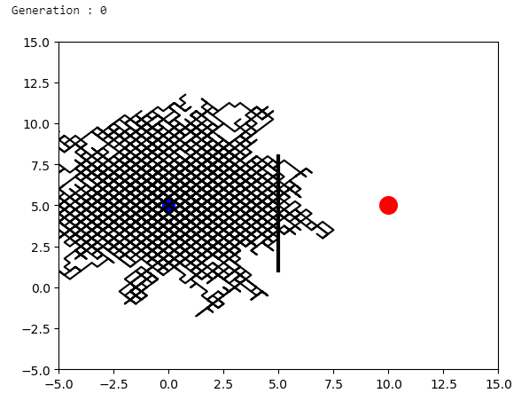
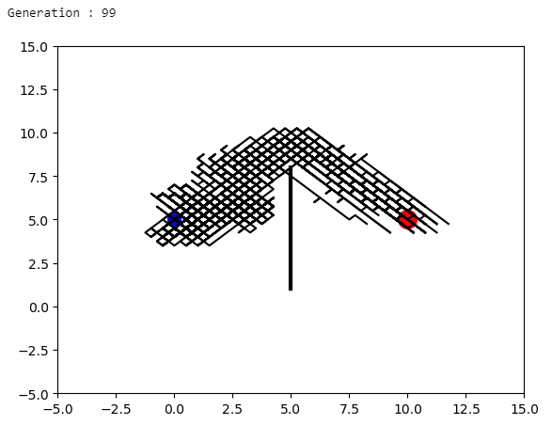
Results using genetic algorithms
Initial random population of paths at generation 0, with a fitness value of 0.016 only. Number of moves = 150, population size = 100 and total generation = 100
Final population of paths at generation 100 with fitness value of 0.55. shortest path shortlisting will result in highest fitness values.

Slide 10
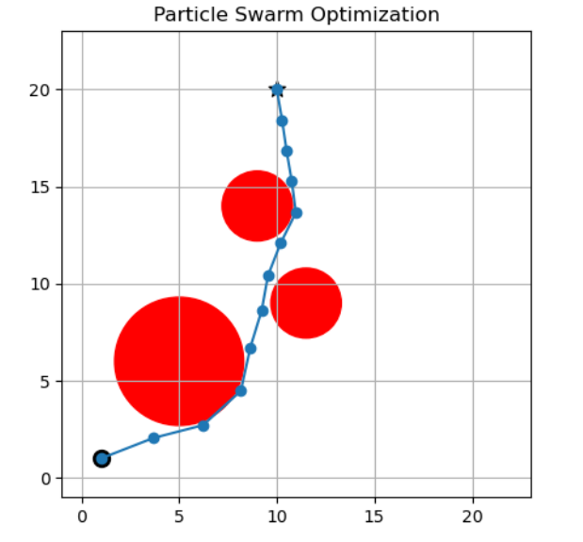
Results using PSO
Total of 100 iterations were used to obtain the P_best paths for each swarm and then finally shortlisting it to the G_best solution.
Tangential approximations with Euclidean distances resulted in proper avoiding of obstacles which can be clearly seen in the picture.
The path chosen is yet not the optimal path but a good path for the problem.

Slide 11
Thank you !

